Slide 1
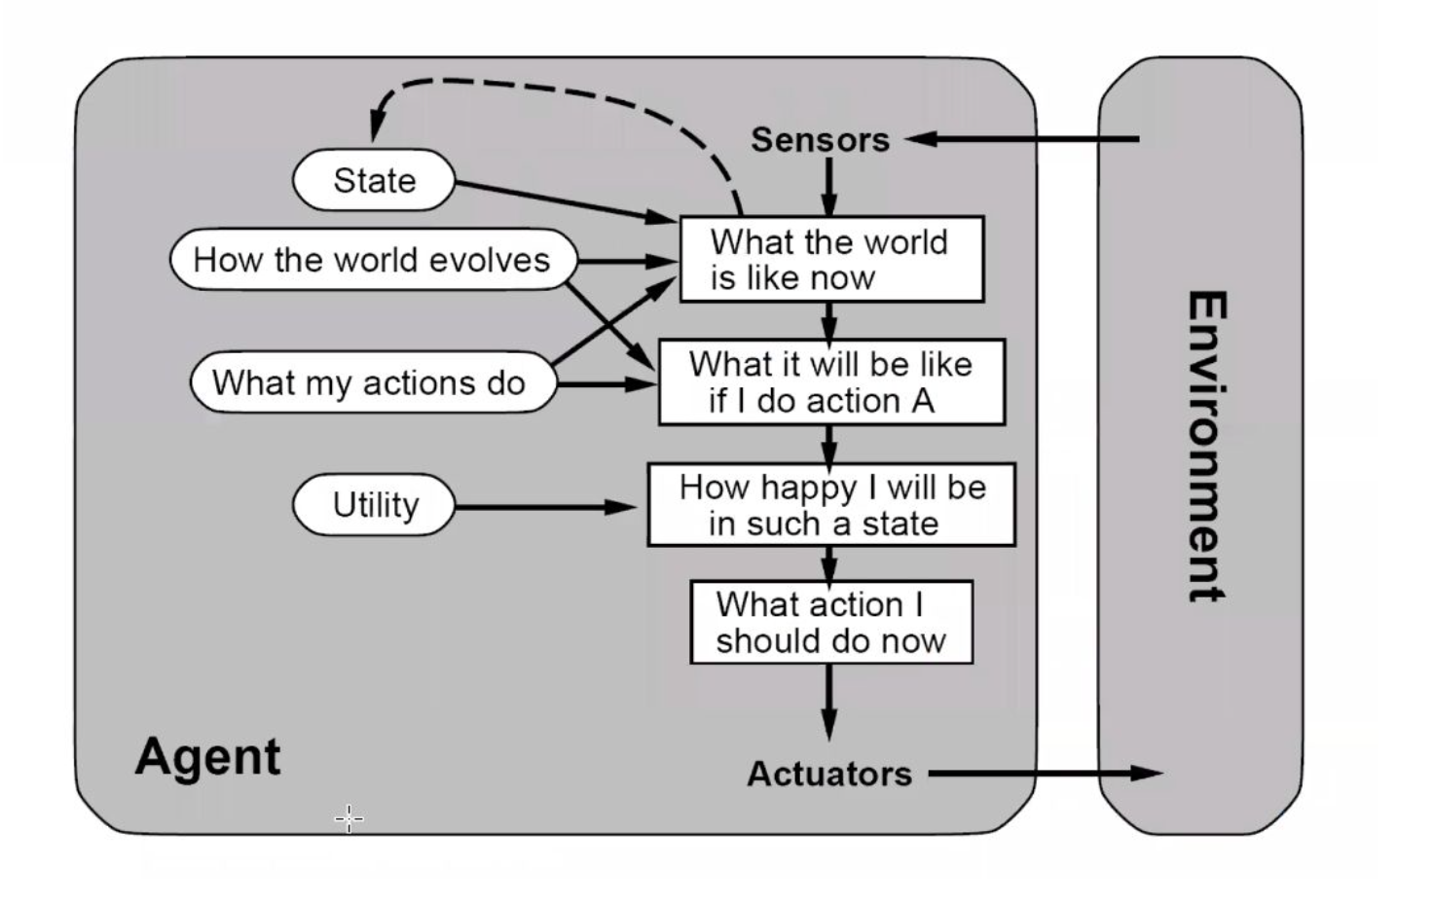
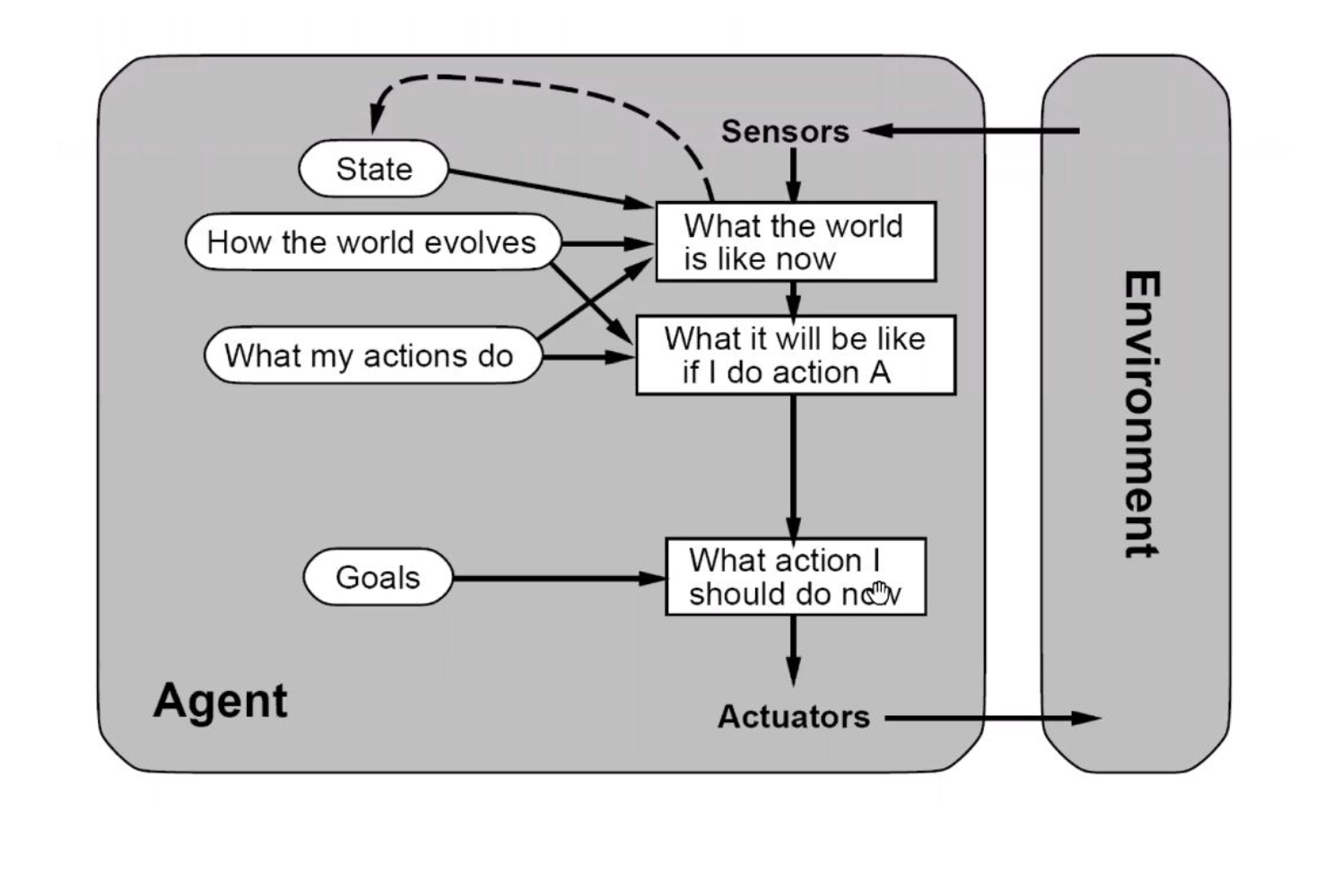
Agents: Goal-based vs Utility-based

Slide 2
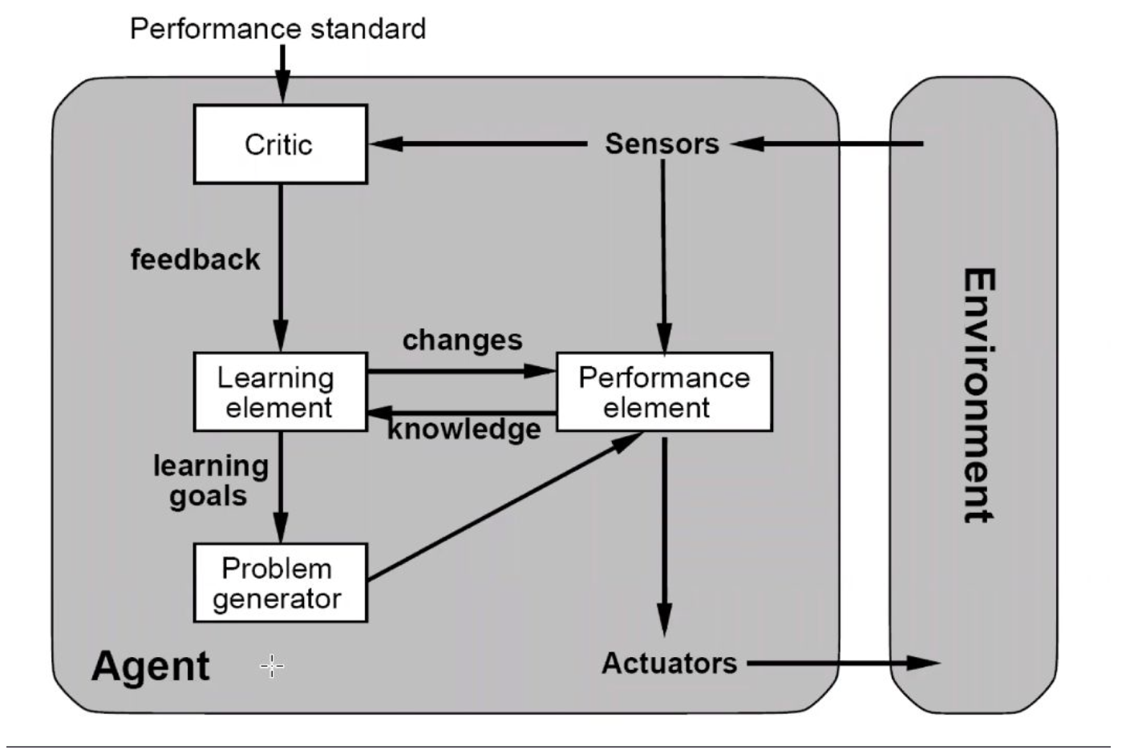
Learning Agent

Slide 3
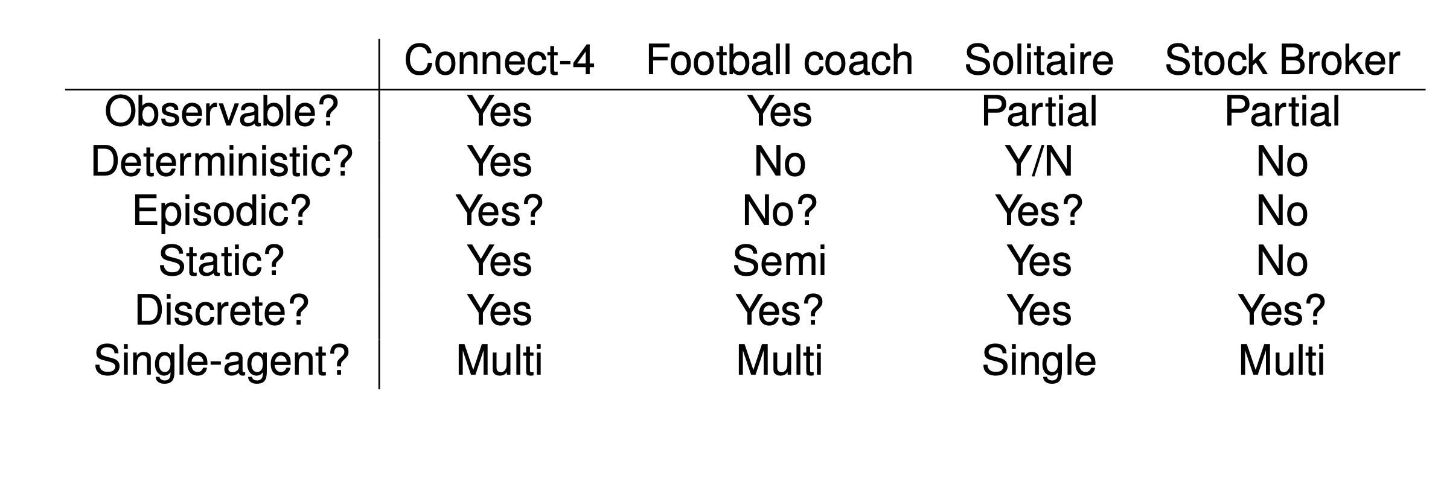

Environment examples
Depends on Agent Algorithm

Slide 4
Topics for today
Decision theory continued
  Risk Neutral and Risk Averse
Probability
  We will be doing problems to understand concepts

Slide 5
PARTICLE FILTER EXAMPLE

Slide 6
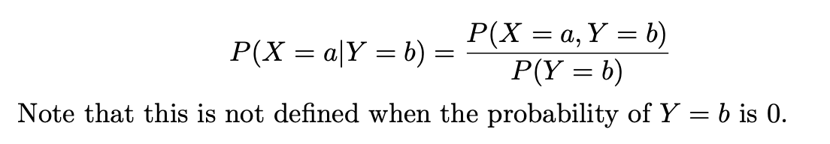
Conditional Probability

Slide 7

Independence

Slide 8
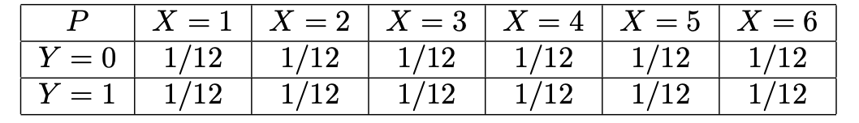
Joint Distributions

Slide 9
Marginal Probability
P(X=1) =
P(X) =

Slide 10
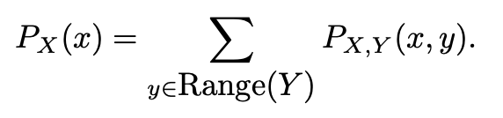
Marginal Probability

Slide 11
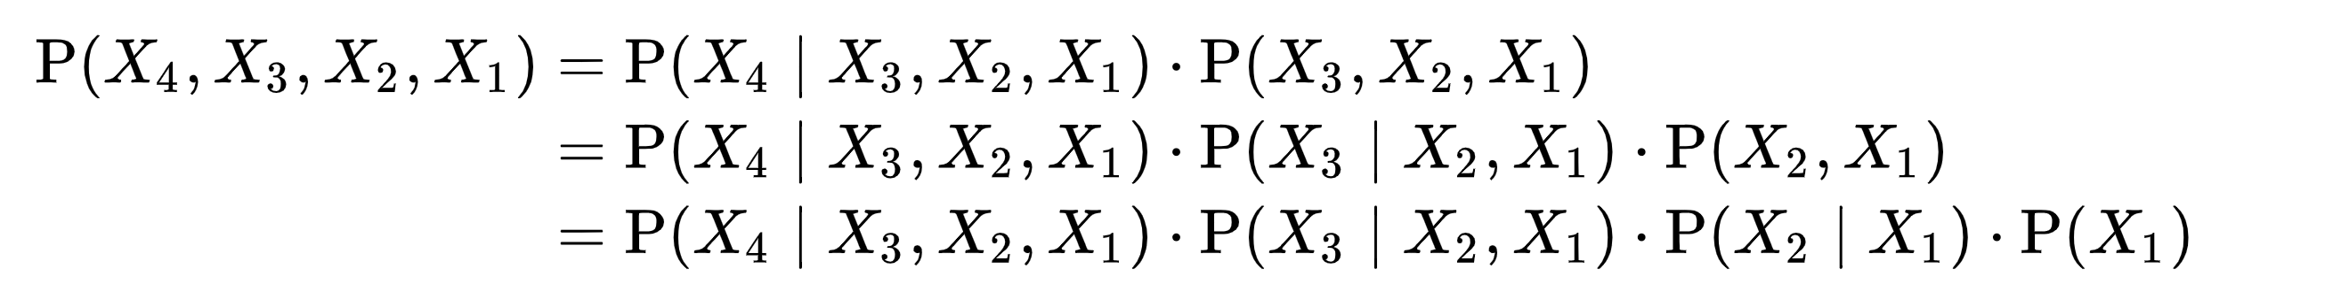
Chain Rule

Slide 12
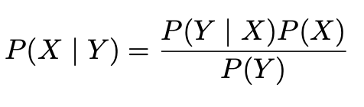
Bayes Rule

Slide 13

Bayes Rule
COIN BIAS EXAMPLE
POSSIBLE BIASES: 0.4, 0.6

Slide 14
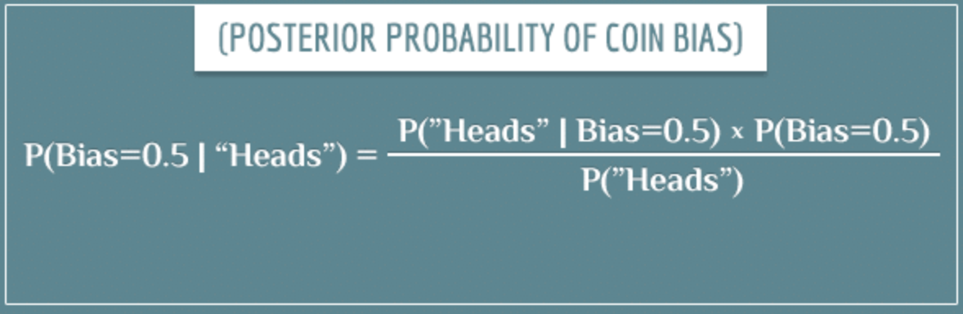
Bayes Rule

Slide 15
Bayes Rule
UPDATING YOUR CURRENT BELIEF HELPS!
That’s what we saw in the particle filter.
Window into what “Learning” looks like.

Slide 16
Learning Agent
Performance Standard: get to know the coin-bias
Try flipping the coin 50m in the air

